Slide 1

Healthcare & Medical Knowledge Retrieval using RAG System
Nitish Adla
Kavya Rampalli
Sai Nischal Dasari

Slide 2

Project Topic and Domain/Corpus
Topic: Healthcare & Medical Knowledge Retrieval using RAG System.
Domain/Corpus: The system will leverage medical research papers, clinical guidelines, and health reports from sources like PubMed, WHO, and CDC.

Slide 3

Statement of Project Objectives
The objectives of this project include:
Develop a RAG system that retrieves and summarizes medical knowledge from trusted sources.
Improve the accuracy and accessibility of medical information for healthcare professionals and researchers.
Evaluate the system using medical domain-specific benchmarks and retrieval effectiveness metrics.

Slide 4

Approach
The system will integrate the following components:
LLM: Open-source medical NLP models like BioGPT, DistilGPT2 ,MiniLM.
Retriever: Dense Passage Retrieval (DPR) fine-tuned on medical literature.
Datasets/Knowledge Base: PubMed abstracts, WHO guidelines, CDC reports, clinical trial results.
System Architecture: The retriever fetches relevant medical data, which is then processed by an LLM to generate accurate responses.
4

Slide 5
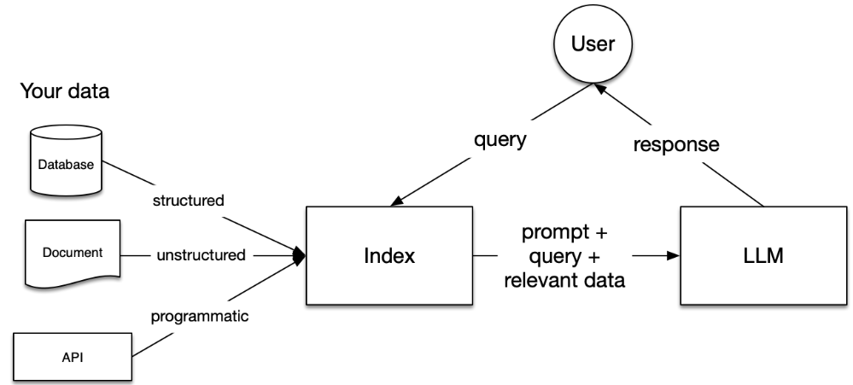
RAG ARCHITECTURE

Slide 6

State of the Art in RAG Systems (1/2)
Recent advancements in RAG systems include:
RAG by Facebook AI, which integrates a retriever and generator into a single end-to-end framework.
Use of dense retrievers like DPR (Dense Passage Retrieval) to enhance retrieval accuracy.
GPT-3 integration with retrieval systems to improve response quality.
Citations: - Lewis, M., et al. (2020). *Retrieval-Augmented Generation for Knowledge-Intensive NLP Tasks*.

Slide 7
State of the Art in RAG Systems (2/2)
Additional works related to RAG systems include:
RAG with BERT-based retrievers to handle domain-specific questions.
Improvements in knowledge base incorporation for handling factual queries.
Citations: - Zhang, Y., et al. (2021). Leveraging Contextual Retrieval for Better Answers in Knowledge-intensive Tasks*.

Slide 8

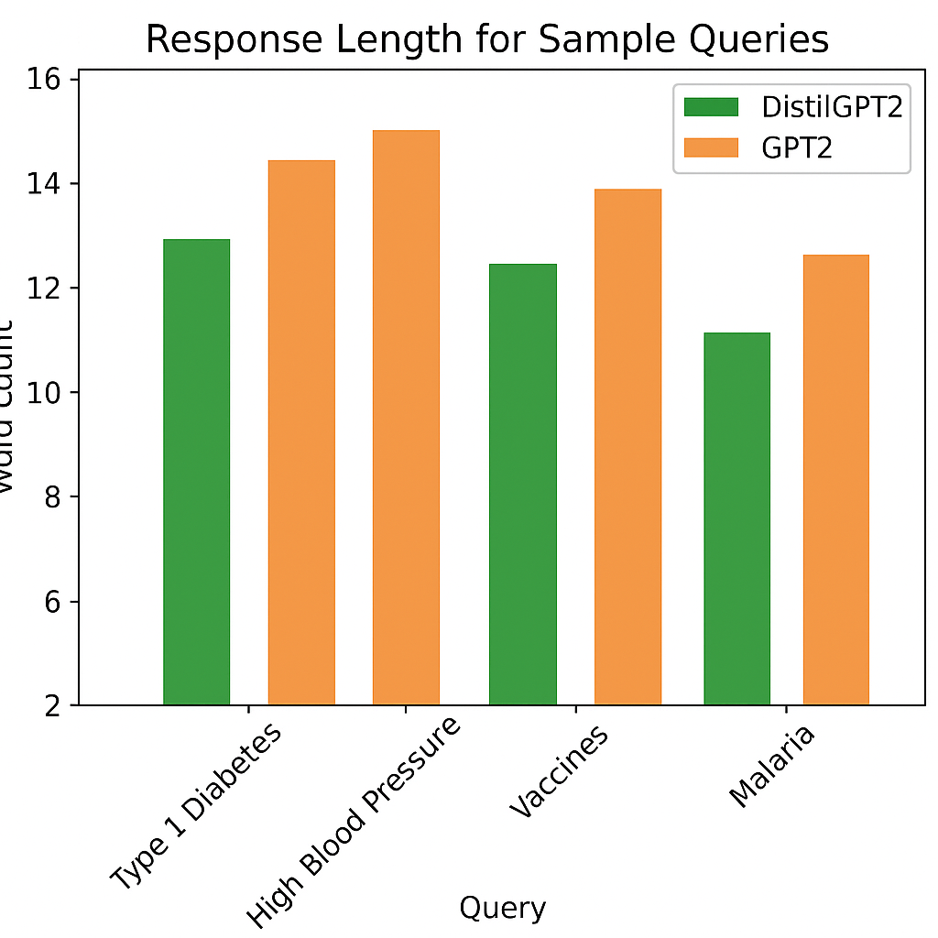
Deliverables
Upon project completion, we will deliver:
A working RAG system tailored for retrieving and summarizing medical knowledge.
Detailed documentation including system architecture, API usage, and deployment instructions.
Evaluation report highlighting the system’s effectiveness in medical knowledge retrieval.
Open-source code repository with all implementations and datasets.
8

Slide 9
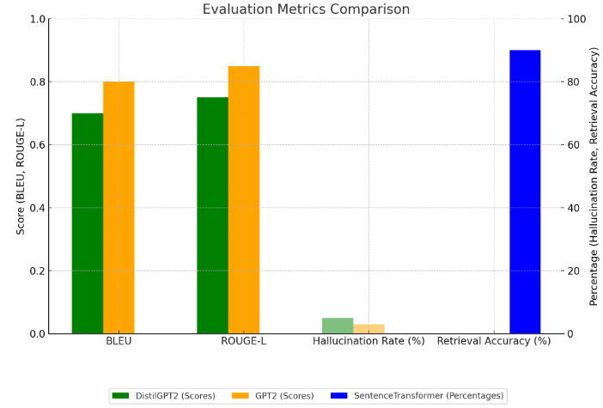
Evaluation Methodology
The system's performance will be assessed based on:
Medical Text Quality: Evaluated using BLEU, ROUGE, METEOR,
and clinical relevance scores.
2. Knowledge Retrieval Accuracy: Assessed by comparing retrieved documents with ground-truth expert-reviewed sources.
3. System Efficiency: Latency (response time) and retrieval speed will be measured.
4. Domain Expert Validation: Feedback from medical professionals to determine the system's reliability in healthcare applications.
9

Slide 10
Results
10

